Slide 1
Designing Your Robot
Kevin Nufer
14 Jun 2017

Slide 2
What do you want to do?
Raise the voltage
Option 1: Boost Converter
Option 2: Get a battery with a higher voltage and use an H-bridge or a transistor
Lower the voltage
Option 1: Buck converter (UBEC)
Option 2: Use a linear regulator (there is a small one on your Arduino, but it can’t handle large amounts of current)

Slide 3
What do you want to do, cont.?
Use a servo
Requires an input of 5V
Use a buck converter on your 7.4V battery source
[what type of pin on Arduino?]
Electromagnet
Requires an input of 12V
Use a boost converter on your 7.4V battery source
H-Bridge (or a transistor/relay)
Stepper Motor
The H-bridge driving the 28BYJ-48 model purchased requires 5-12 V input
Voltage input needs to be directly from the battery (or at least not through the Arduino)

Slide 4
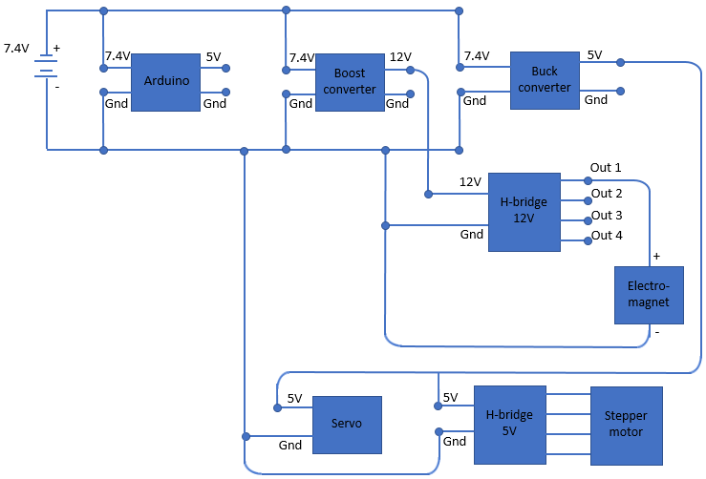
Subsystem example
To the right is an electrical diagram of a subsystem with an electromagnet, servo, and stepper motor
Not shown:
-The robot car
-The H-bridge and servo connections to the Arduino pins

Slide 5
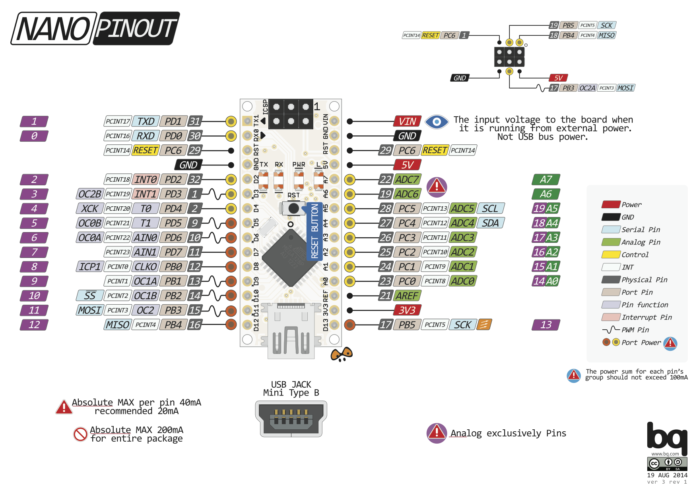
The purple numbers are how the Arduino IDE references them
The green numbers are different ways to refer to the same pin. Sayin pin A1 in your code (aka, Analog pin 1) is the same as saying pin 13. You can refer to that pin in your code as either one.
Pins D3, D5, D6, D9, D10, and D11 (3, 5, 6, 9, 10, and 11 in the Arduino IDE) are digital pins capable of PWM output using AnalogWrite()
Graphic source: http://www.pighixxx.com/test/wp-content/uploads/2014/11/nano.png

Slide 6
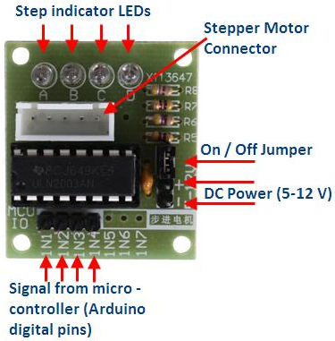
Connecting the Stepper Motor H-bridge to the Arduino
Connect the ULN2003 driver IN1, IN2, IN3 and IN4 to digital pins D3, D4, D5 and D6 respectively on the Arduino Nano.
These pins are necessary if you are using the “AccelStepper” library (which, if you use my code, you are)
Connect the positive lead from a decent 5-12V battery pack to the “+” pin of the ULN2003 driver and the ground to the “-” pin.
Make sure that the “on/off” jumper next to the “-” pin is on
If you power the Arduino from a different battery pack, connect the grounds together.

Slide 7


Servo
http://www.electronicoscaldas.com/datasheet/MG995_Tower-Pro.pdf
Specs
Stall torque: 8.5 kgf·cm (4.8 V ), 10 kgf·cm (6 V)
Operating speed: 0.2 s/60º (4.8 V), 0.16 s/60º (6 V)
Operating voltage: 4.8 V a 7.2 V
Rotates 120 degrees
How to hook up:
Red wire to positive (off of buck converter)
Black wire to ground
Orange wire to a Digital Pin
See the Arduino Nano diagram on slide 5: any pin with a ‘D’ in front of it; reference it in the Arduino IDE by the purple number

Slide 8
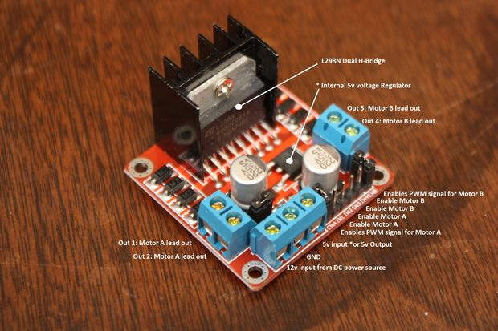
Electromagnet (using H-bridge)
H-bridge used: L298N
Electrical setup:
Supply the 12V input on the H-bridge with the wire coming off the positive output of the boost converter
The negative terminal output wire from the boost converter should be connected to the negative terminal of the H-bridge
One wire from the electromagnet should go to Output1 on the H-bridge
The other wire from the electromagnet should go to ground on the H-bridge
if the code below turns the electromagnet off when it should be on and on when it should be off, switch the wires on the electromagnet (aka, output 1 goes to ground, ground goes to output1)
IN1 on the H-bridge should be connected to Analog Pin A0 on the Arduino Nano (or whichever Arduino Nano pin is called out for HbridgeElectromagnetPin)
H-bridge tutorials: https://tronixlabs.com.au/news/tutorial-l298n-dual-motor-controller-module-2a-and-arduino/
http://www.instructables.com/id/Arduino-Modules-L298N-Dual-H-Bridge-Motor-Controll/

Slide 9
Suggested pin selections for your subsystem
One stepper motor:
Control H-bridge using pins D3, D4, D5, and D6
First servo: D7 (can be any unused digital pin)
Second servo: D8 (can be any unused digital pin)
Electromagnet:
Extra ultrasonic rangefinders:
Second stepper motor:

Slide 10
Intro to Pulse Width Modulation (PWM)
(explanation of PWM)

Slide 11
Notes on Analog vs Digital Pins
Differences
Digital is like a light switch—it is either on or off
digitalRead() will either give you LOW or HIGH (or 0 and 1), depending on if it reads high or low voltages
digitalWrite() will set your pin to either high or low voltages
Both digitalRead() and digitalWrite() can be used on all pins, whether that pin is analog or digital! (with exception of A6 and A7—analog input only)
Analog can read intermediate values from 0-1023, and write values from 0 – 255
Good for reading potentiometers for example
Digital pins that are Pulse Width Modulation (PWM)-capable can analogWrite(); these digital pins are 3, 5, 6, 9, 10, and 11
Only analog pins can analogRead()
Note: servos DO NOT need analog pins
Good discussions:
https://electronics.stackexchange.com/questions/67103/can-i-use-the-analog-pins-on-the-arduino-for-my-project-as-digital
https://forum.arduino.cc/index.php?topic=357562.0

